Slide 1

CSE 464 Software Quality Assurance and Testing
Static Testing : Reviews and Inspections

Slide 2
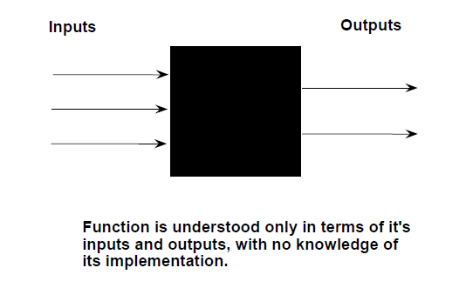
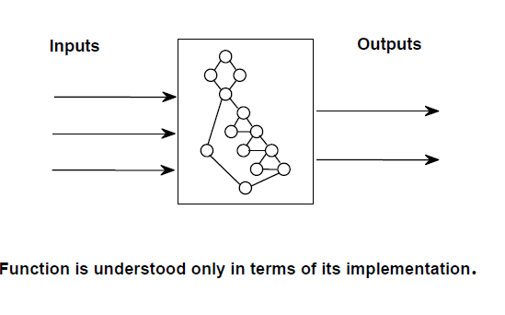
Quick Recap
Software quality and quality assurance activities
So far, we focused on dynamic testing where code / software is available and test cases are designed and executed against the code.
Relative strengths and weaknesses of software testing approaches.
Now its time for us to think about few other aspects of software quality assurance.

Slide 3
The Test Method Pendulum

Slide 4
Static Testing
Another important aspect of software quality assurance is to inspect and review various artifacts of a software project without executing the code
Static testing is NOT a replacement for dynamic testing

Slide 5
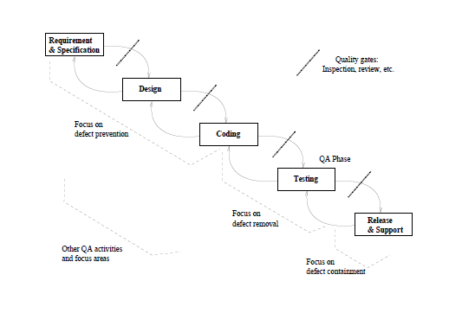
Quick Recap: Quality Assurance Activities in the Waterfall Model

Slide 6
What is Review?
IEEE standard for software review identify four different types of reviews
a) Management reviews
b) Technical reviews
c) Inspections
d) Walk-throughs
e) Audits
What do we review? : Requirements, Specification, Design, Code, User guides, Test cases, …etc

Slide 7
Few definitions
management review: A systematic evaluation of a software acquisition, supply, development, operation, or maintenance process performed by or on behalf of management that monitors progress, determines the status of plans and schedules, confirms requirements and their system allocation, or evaluates the effectiveness of management approaches used to achieve fitness for purpose.
Technical Review :
Evaluate the product to determine its suitability for its intended use. Identify discrepancies from specification and standards.

Slide 8
Few definitions
Inspection :
A formal evaluation technique in which software requirements, design, or code are examined in detail by person or group other than the author to detect faults, violations of development standards, and other problems [IEEE94]. Here, documents or code is provided to reviewers beforehand.
Walkthrough:
Another formal process in which the author of the code formally presents the requirements, design, or code to a small group reviewers. Reviewers listen and ask questions.

Slide 9
Few definitions
audit: An independent examination of a software product, software process, or set of software processes to assess compliance with specifications, standards, contractual agreements, or other criteria.

Slide 10
Informal (Technical) Reviews
Informal reviews include:
  a simple desk check of a software engineering work product with a colleague
  a casual meeting (involving more than 2 people) for the purpose of reviewing a work product, or
  the review-oriented aspects of pair programming
pair programming encourages continuous review as a work product (design or code) is created.
  The benefit is immediate discovery of errors and better work product quality as a consequence.

Slide 11
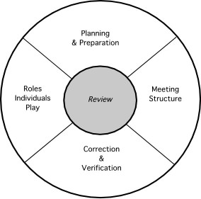
Review: Reference Model

Slide 12
Formal Technical Reviews (FTR)
The objectives of an FTR are:
  to uncover errors in function, logic, or implementation for any representation of the software
  to verify that the software under review meets its requirements
  to ensure that the software has been represented according to predefined standards
  to achieve software that is developed in a uniform manner
  to make projects more manageable
The FTR is actually a class of reviews that includes walkthroughs and inspections.

Slide 13
The Review Meeting
Between three and five people (typically) should be involved in the review.
Advance preparation should occur but should require no more than two hours of work for each person.
The duration of the review meeting should be less than two hours.
Focus is on a work product (e.g., a portion of a requirements model, a detailed component design, source code for a component)

Slide 14
A Typical Review Meeting
review
leader
standards bearer (SQA)
producer
maintenance
oracle
recorder
reviewer
user rep

Slide 15
The Players
Producer—the individual who has developed the work product
  informs the project leader that the work product is complete and that a review is required
Review leader—evaluates the product for readiness, generates copies of product materials, and distributes them to two or three reviewers for advance preparation.
Reviewer(s)—expected to spend between one and two hours reviewing the product, making notes, and otherwise becoming familiar with the work.
Recorder—reviewer who records (in writing) all important issues raised during the review.

Slide 16
Conducting the Review
Review the product, not the producer.
Set an agenda and maintain it.
Limit debate and rebuttal.
Enunciate problem areas, but don't attempt to solve every problem noted.
Take written notes.
Limit the number of participants and insist upon advance preparation.
Develop a checklist for each product that is likely to be reviewed.
Allocate resources and schedule time for FTRs.
Conduct meaningful training for all reviewers.
Review your early reviews.

Slide 17
Code Review Checklist : Some Examples

Slide 18
Code review checklist: Code writing errors
Data declaration errors
Are the variables assigned the correct length, type, storage class?
  E.g. should a variable be declared a string instead of an array of characters?
If a variable is initialized at its declaration, is it properly initialized and consistent with its type?
Computation errors
Do any calculations that use variables have different data types?
  E.g., add a floating-point number to an integer
Do any calculations that use variables have the same data type but are different size?
  E.g., add a long integer to a short integer
Is overflow or underflow in the middle of a numeric calculation possible?
Control flow errors
Comparison errors
Are the comparisons correct?
  E.g., < instead of <=
Properly comparing decimal values?
  Use EPSILON
Do the loops terminate? If not, is that by design?
Does every switch statement have a default clause/break after cases?

Slide 19
Code review checklist – code design issues
Some Smelly code symptoms
Duplicated Code
  bad because if you modify one instance of duplicated code but not the others, you (may) have introduced a bug!
Long Method
  long methods are more difﬁcult to understand
Large Class
  classes try to do too much, which reduces cohesion (will talk about cohesion and coupling next time)
Long Parameter List
  hard to understand, can become inconsistent
Temporary Field
  An attribute of an object is only set in certain circumstances; but an object should need all of its attributes

Slide 20
Code review checklist: Code Complexity
Code Risk Analysis : Complexity of the code
One of the commonly used criteria is cyclomatic complexity
  1 – 10 Simple module, little risk
  11- 20 moderate risk
  21 – 50 Complex module, high risk
  >50 ALMOST Untestable, VERY HIGH RISK

Slide 21
Code Review- Bar Graph program Example

Slide 22
Code Review Tools
  Sonorqube :
  https://www.sonarqube.org/
FindBugs:
  Static code review plugin for eclipse.
  Its analyzes the code for about 200 possible bugs such as unused variables, memory allocation/de-allocation issues …etc.
  http://findbugs.sourceforge.net/bugDescriptions.html

